Slide 4
Default Bullet
Checkmark Bullet
Addition Bullet
Regular Bullet

Slide 7














LEARN MORE
LEARN MORE

Slide 11
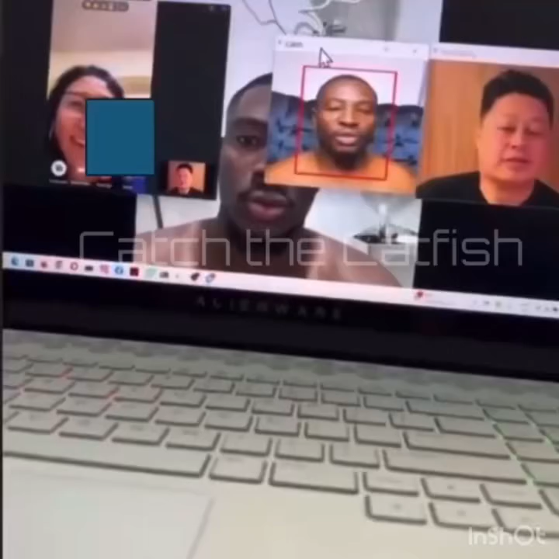

Slide 12


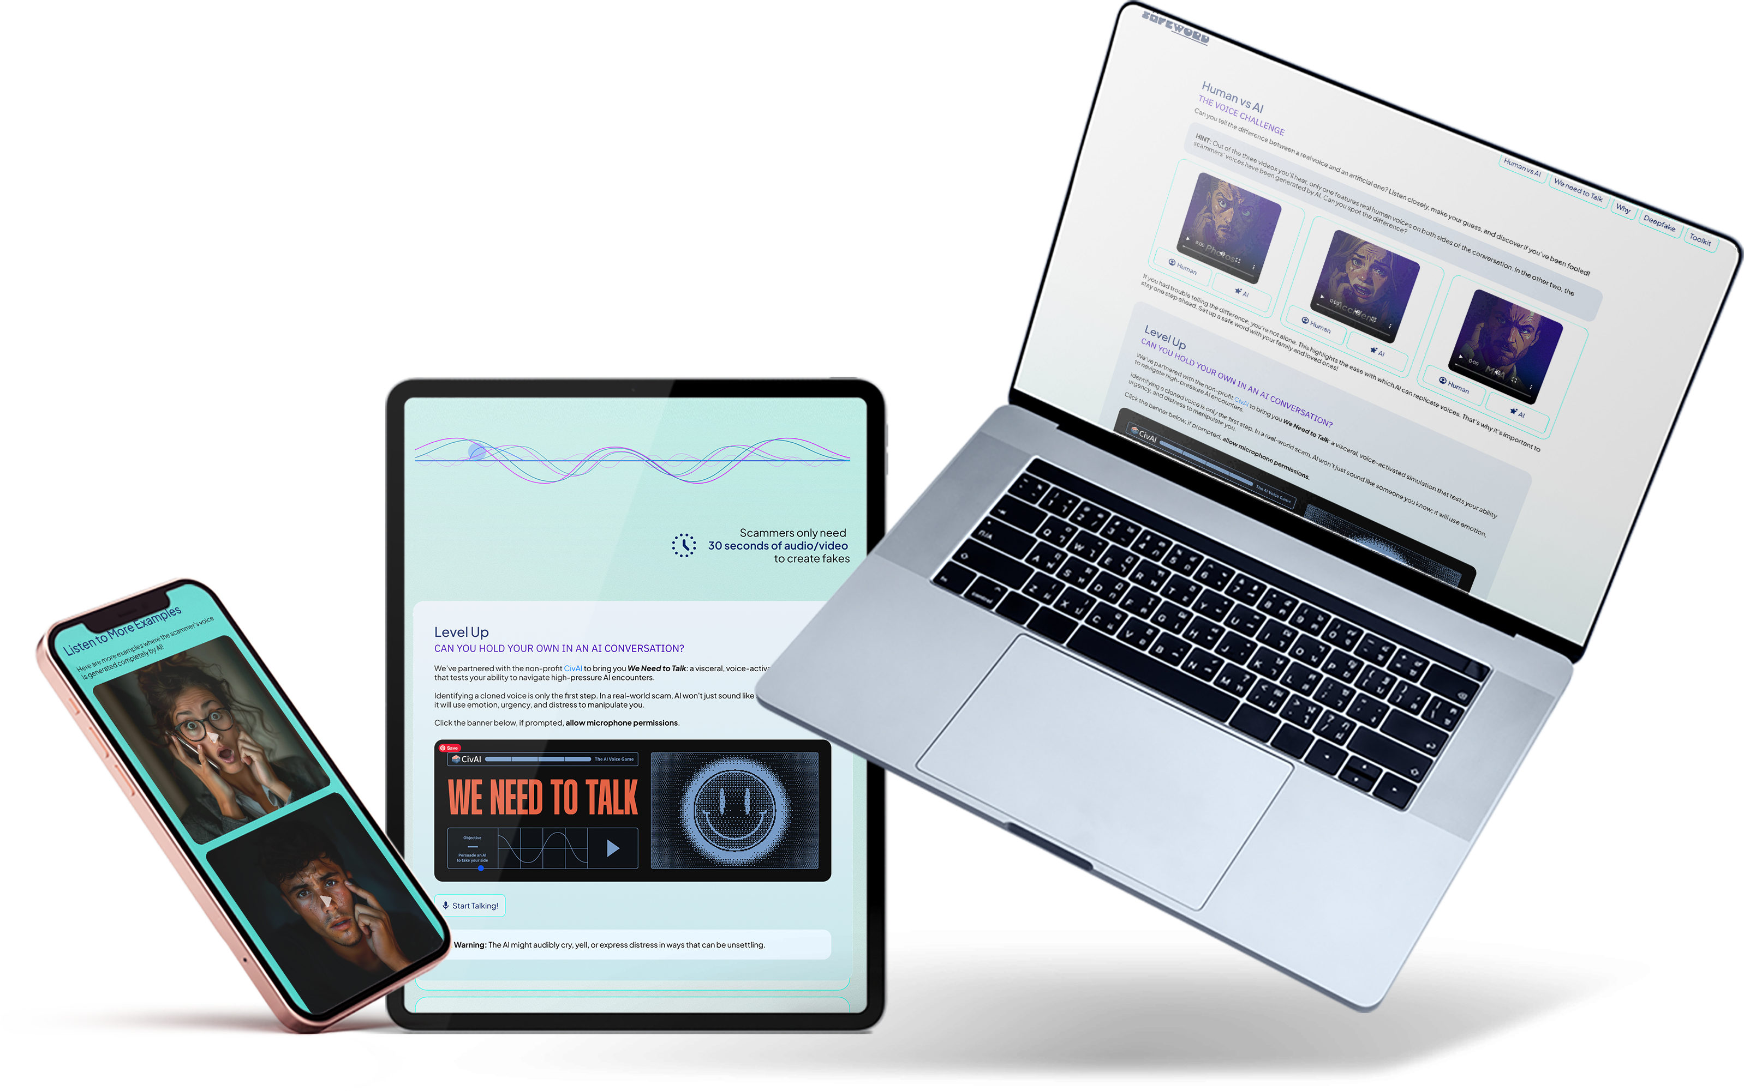
The AI Voice Challenge!

Slide 13

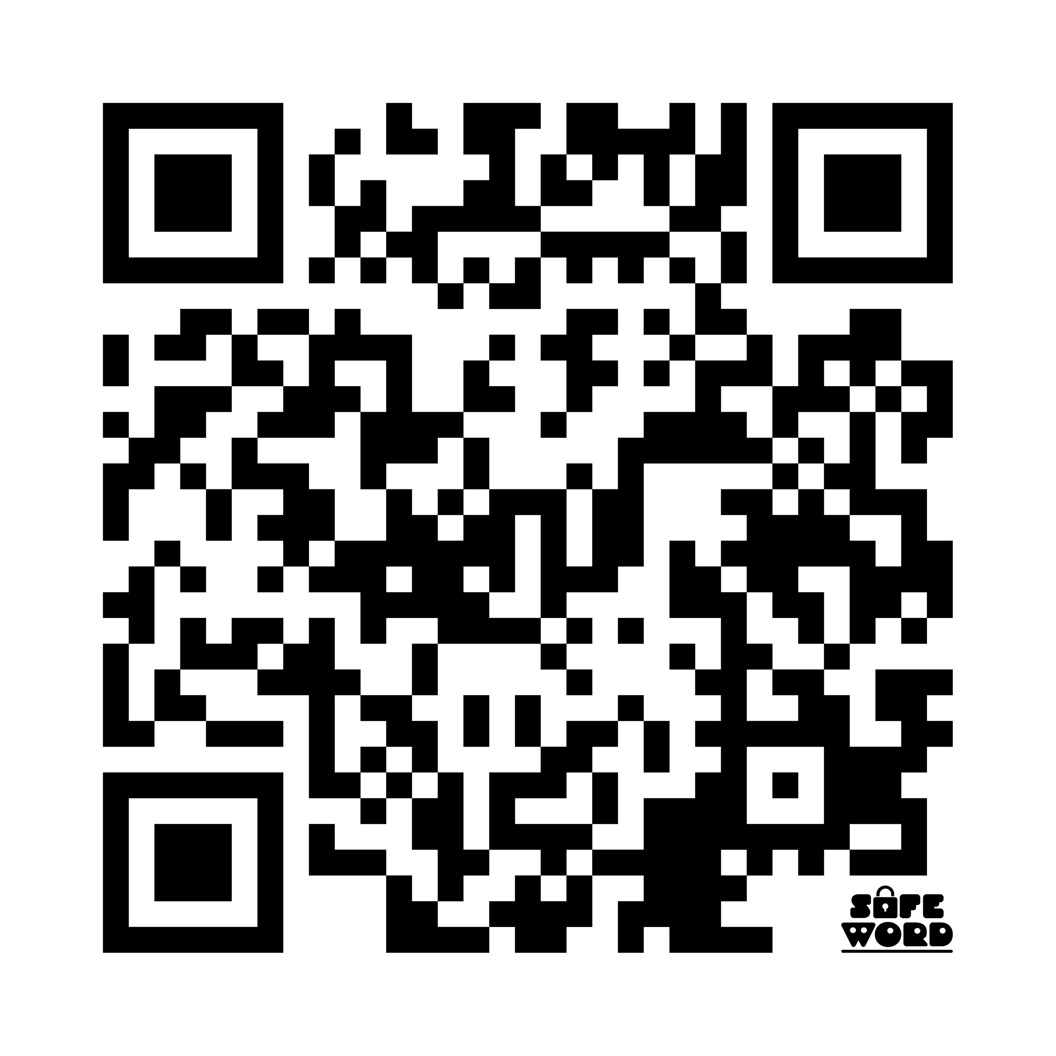


Try the deepfake tool!
SafeWord.StaySafeOnline.org
Persuade the AI
Notes:
In colabation with the nonprofit CivAI, we created 2 additional education materials.
Deepfake tool, snap your picture, get your deepfake in 5 seconds
”We need to talk” persuade an AI to take your side in destressing series of conversations

Slide 14

Stay Safe Online
Workbook
ThenAndNow.info

Slide 15

Contact the ITRC for Help
Call: (888) 400-5530
Email: ITRC@IDTheftCenter.org
Live Chat: IDTheftCenter.org
© 2026 IDENTITY THEFT RESOURCE CENTER, ALL RIGHTS RESERVED | 888.400.5530 | IDTHEFTCENTER.ORG

