Slide 1
Then & Now
Online Safety for Older Adults

Slide 2


The Problem
THEN & NOW
01
Long-term financial struggle due to the loss of savings and retirement accounts
According to the FBI, Americans over age 60 reported almost $5 billion in total fraud losses in 2024—more than any other age group. They also submitted the greatest number of complaints. Scams can have significant, long-lasting financial and emotional impacts, beyond the ongoing effects of identity theft:
02
Emotional distress of being victimized
03
Physical health impacts due to the stress and turmoil
04
Shame, embarrassment and loss of trust
05
Social and relationship strain

Slide 3
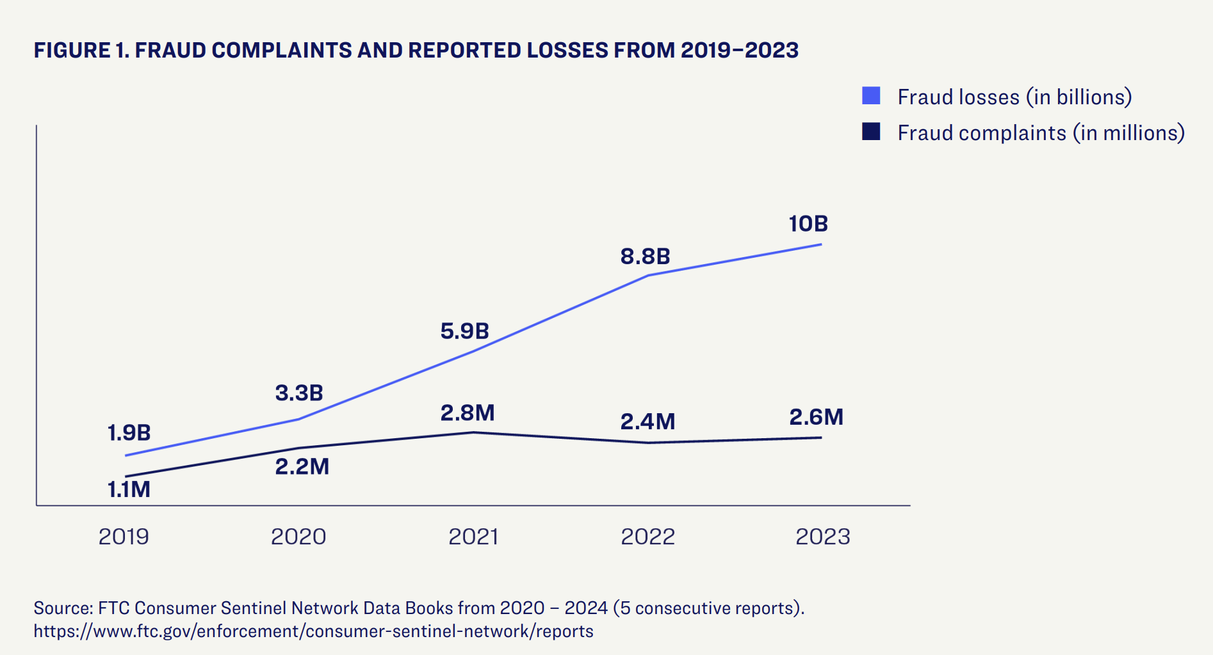

Slide 4
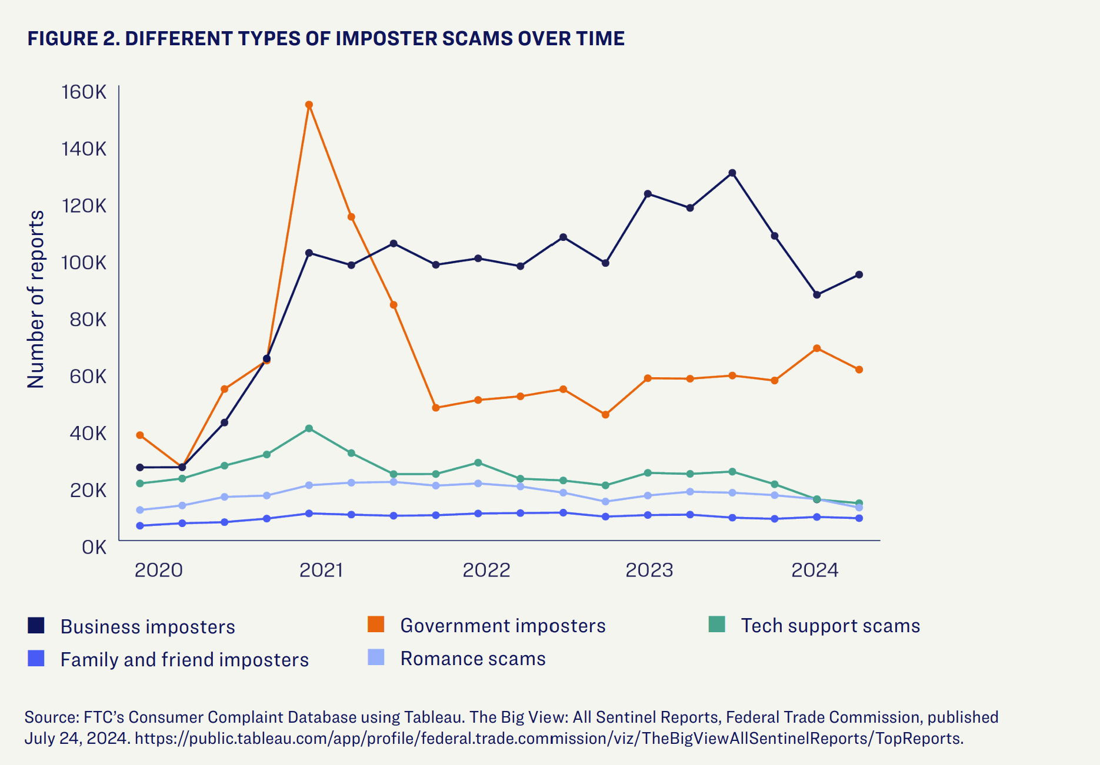
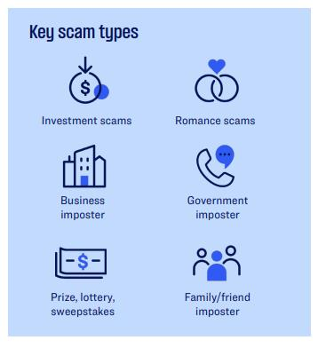

Slide 5
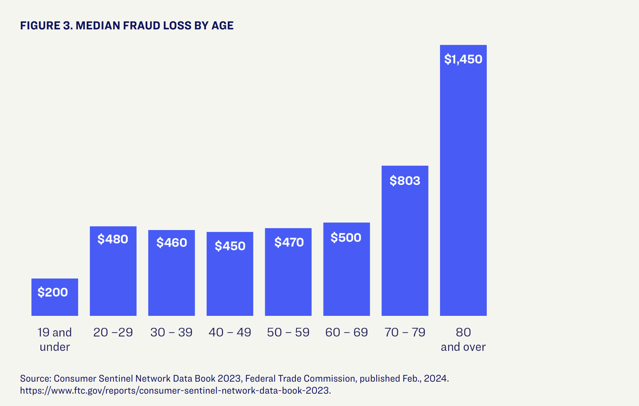

Slide 6

THEN & NOW
WHAT WE KNOW ABOUT THIS DEMOGRAPHIC
According to our research, older adults are:
Less confident than younger generations in their ability to recognize malicious links and AI generated content
More likely to feel that they could be a target of cybercrime
Less likely to find it easy to stay secure when they are online
More optimistic and feel like losing money or personal info on the internet is avoidable (teachable)
More likely to see the value in protecting themselves online
WHAT THEY’VE TOLD US
They know they’re being targeted
They’re angry that they’re being targeted
They’re overwhelmed
But they persevere

Slide 7
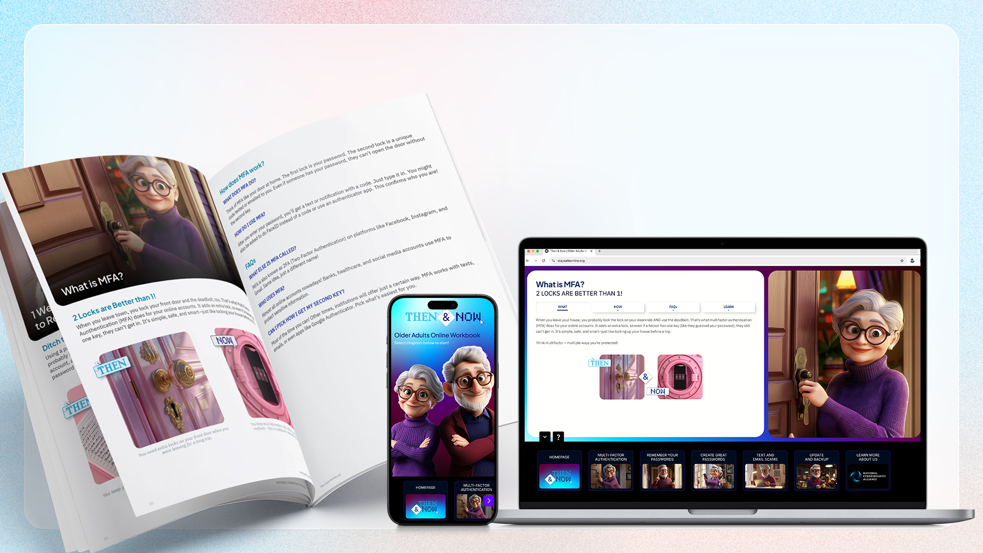



SPONSORED BY
We created
to help!
An education campaign for older adults with step-by-step actions they can take to protect themselves and feel confident in their use of technology.

Slide 8

THEN & NOW
SAFETY ADVICE FOR OLDER ADULTS AGE 60+ AND THEIR CARETAKERS
Step-by-step instructions breaking down top tips for staying safe online.
TOPICS COVERED
Scams and fraud
Multifactor authentication
Passwords and password managers
Software updates
TYPES OF CONTENT
An online workbook with physical copies available to order
How-to videos on setting up cybersecurity best practices on popular platforms
Articles specifically for older adults and their caretakers
Hands-on live workshops upon request

Slide 9


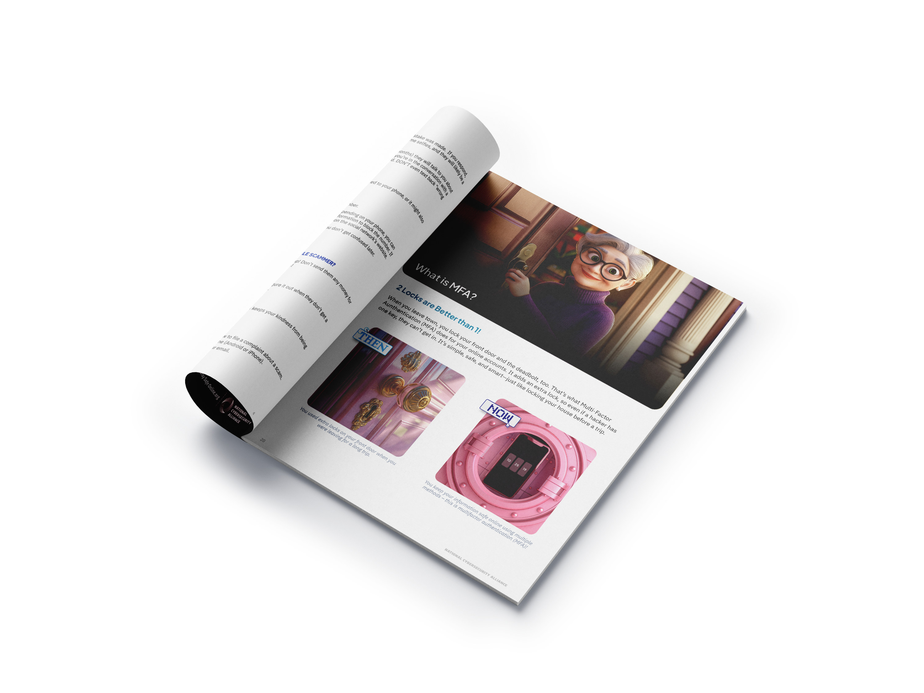
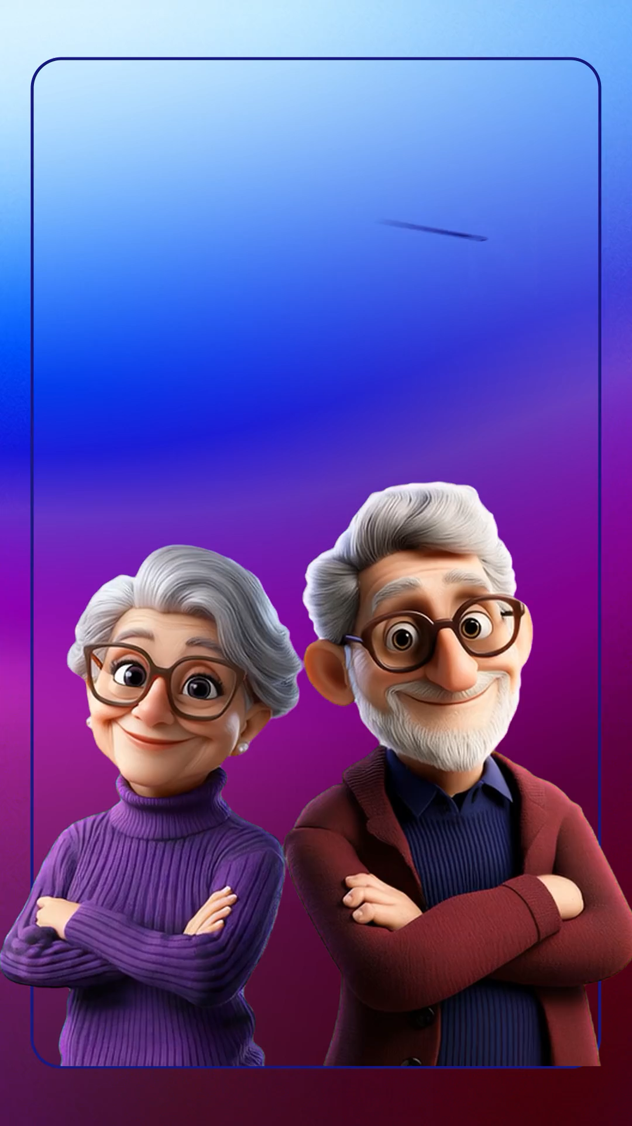

Slide 10
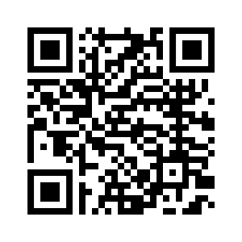
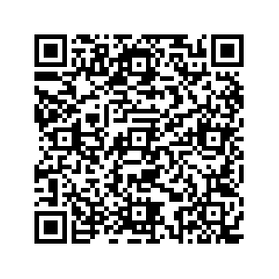
Visit thenandnow.info
Order a workbook

Slide 11
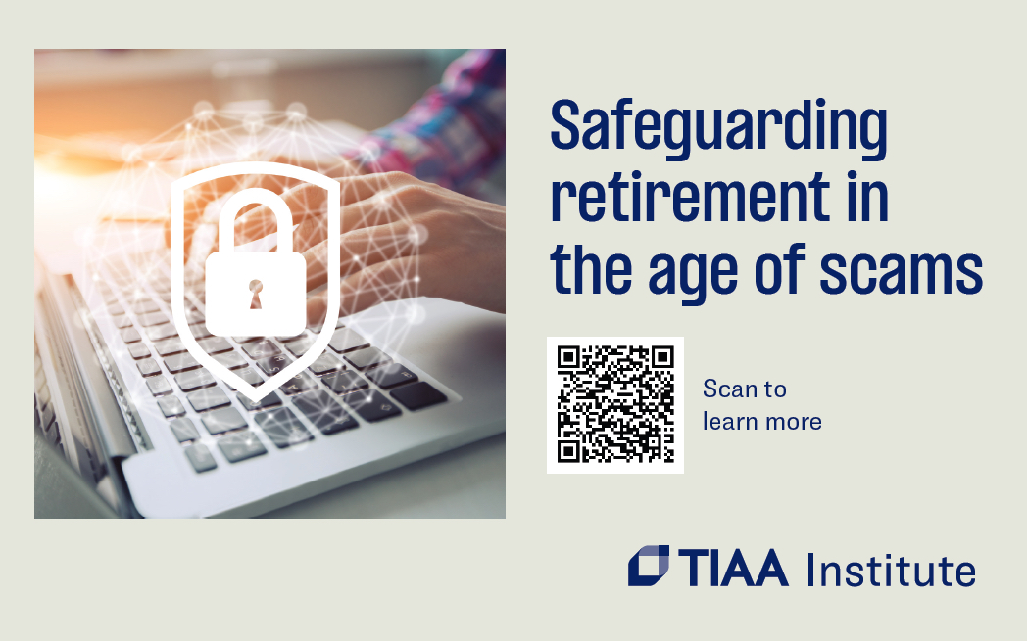

Slide 13


